Slide 1



Influo AI
2026
influoai.co
Influo
AI
Turn your audience into income.
Get discovered. Set your rate. Get paid.

Slide 2


Influo AI
2026
influoai.co
Cold-pitching brands in the DMs - and getting ghosted. Designing media kits and PowerPoints over and over. Chasing invoices to actually get paid. No proof of the results you drive.
BEING A CREATOR IS HARD ENOUGH.

Slide 3



Influo AI
2026
influoai.co
MEET INFLUO
A creator marketplace where brands come to you. Set up your profile once. When a brand searches for someone like you, you show up in their shortlist - no pitching required.
BRANDS FIND YOU
NO PITCHING REQUIRED
ONE PROFILE, ALL DEALS

Slide 4


Influo AI
2026
influoai.co
HOW IT WORKS
BUILD A FREE PROFILE
GET FOUND BY BRANDS
ACCEPT DEALS ON YOUR TERMS
GET PAID + TRACK EVERYTHING
Build a free profile in about 3 minutes. Brands search by niche, audience & location. Accept real briefs with rates and deadlines. Get paid and track everything in your dashboard.

Slide 5



Influo AI
2026
influoai.co
REPLACE YOUR MEDIA KIT
YOUR CREATOR PAGE
ONE PORTFOLIO LINK
SHOW YOUR BEST WORK
YOUR NICHES
PAST PARTNERSHIPS
BRANDS SEE IT ALL
NO MORE SLIDE DECKS
SHARE ANYWHERE

Slide 6

Influo AI
2026
influoai.co
YOUR SHOP LINK
ALL YOUR LINKS IN ONE PLACE
Your favorite picks, brand partnerships, and affiliate links live on one page - influoai.co/shop/yourname. Share it anywhere.
FAVORITE PICKS
BRAND PARTNERSHIPS
AFFILIATE LINKS IN ONE PAGE

Slide 7

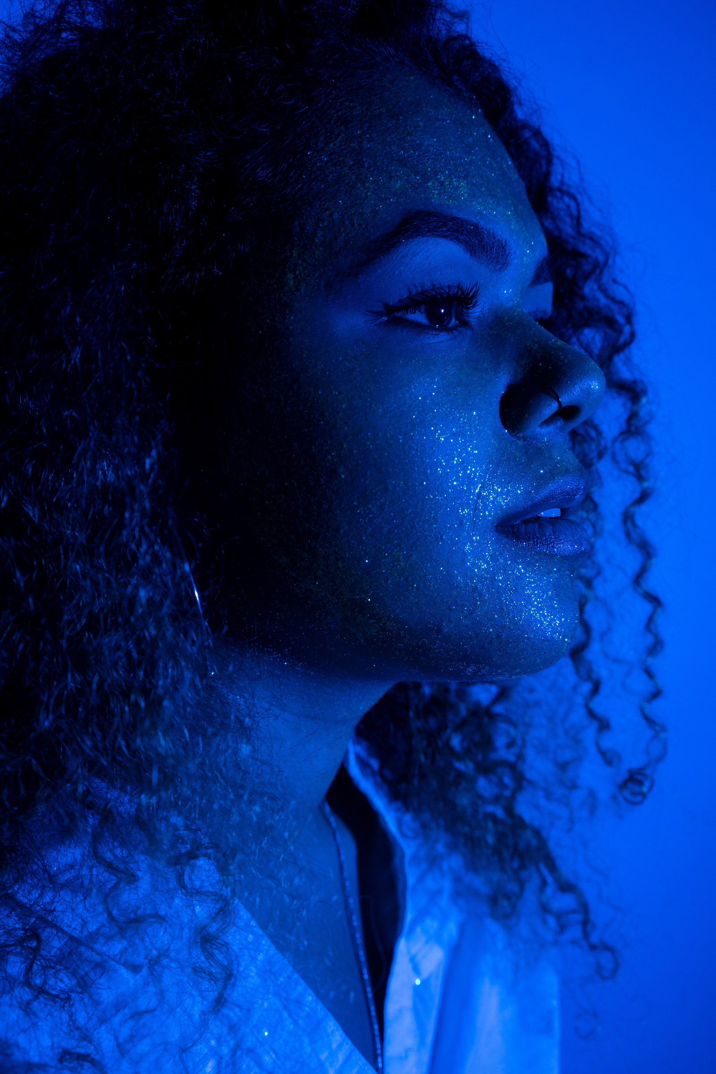
Influo AI
2026
influoai.co
AFFILIATE EARNINGS
Add affiliate links and earn a commission on every click and sale they drive - automatically, on top of your flat fee. Watch earnings in your dashboard.
GET PAID
COMMISSION
on every click and sale
DASHBOARD
track earnings automatically

Slide 8


Influo AI
2026
influoai.co
YOUR RATE IS YOUR RATE
ZERO CREATOR FEES
NO COMMISSION
Platform fees are charged to brands - never to you. You keep exactly what brands agree to pay.
No commission on your campaign earnings. What you negotiate is what you receive - simple as that.
Affiliate commission: 10%

Slide 9

Influo AI
2026
influoai.co
Pick only the deals worth your time. Set your own price up front. Get only relevant offers - no spam. Accept, negotiate, or skip - your call. Optional Boost to appear first in searches.
YOU'RE IN CONTROL
SET YOUR PRICE
accept, negotiate, skip
OPTIONAL BOOST
appear first in searches

Slide 10
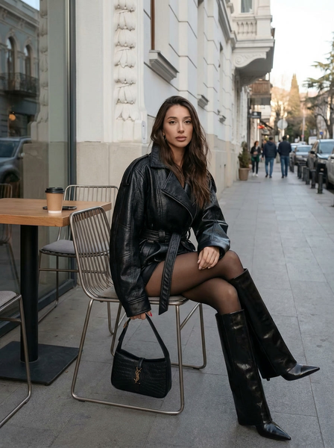

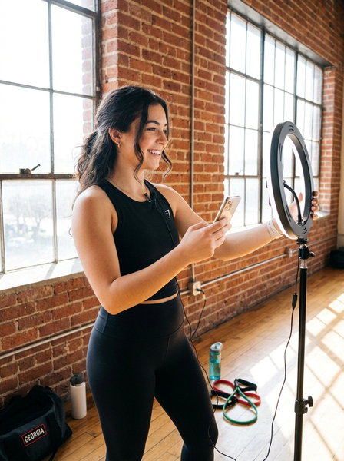
Influo AI
2026
influoai.co
FREE LISTING
NO SUBSCRIPTION
JUST SET UP
START EARNING TODAY
GET FOUND & START EARNING
No subscription, no card. Just set up, get found, and start earning.
Listing your profile is free. No subscription. Just set up, add your Georgian IBAN, get found, and start earning.
Listing your profile is free. No subscription. Just set up, get found, and start earning.

Slide 11



Influo AI
2026
influoai.co
BUILT FOR OUR REGION
TBILISI
WIDER CAUCASUS
LOCAL BRANDS, LOCAL CREATORS, REAL OPPORTUNITIES

Slide 12

Influo AI
2026
influoai.co
STOP PITCHING. START EARNING.
Stop cold-pitching. Stop chasing invoices. Set up once, get discovered, and get paid - all in one place. influoai.co
List your profile free today. Join the creator marketplace where brands come to you.

